Slide 1

Exchange store
Kuzey Arda Bulut Cybersecurity
Tallinn University of Technology
26.09.2025

Slide 2
Problem Statement & Scope
Problem Statement: Customers often face confusion when converting currencies due to unclear exchange rates and inconsistent denomination handling. Manual tracking of reserves and profits is error-prone. Administrators lack accurate reports to evaluate daily performance.
Scope:
System allows customers to exchange between supported currencies
Balances and reserves are updated in real-time after each transaction
Receipts are generated for customers and daily reports for management
Cashiers can view exchange rates and manage reserves
(Excluded: internet-based real-time rate updates, mobile app integration, multi-branch synchronization)

Slide 3
User Stories
As a customer, I want to see the current exchange rates so that I can decide quickly whether to proceed with a transaction.
Acceptance Criteria: Exchange rates are displayed immediately upon request and match the system’s stored values.
As a customer, I want the system to prevent an exchange when reserves are insufficient so that I don’t waste time.
Acceptance Criteria: System shows “Insufficient Reserves” if the requested payout cannot be fulfilled.
As a cashier, I want balances and reserves to update instantly after each transaction so that I always have accurate availability.
Acceptance Criteria: Reserve values match internal data after each exchange, tested with 10+ transactions.

Slide 4
User Stories
As a manager, I want the system to log all transactions so that I can generate accurate reports.
Acceptance Criteria: Each transaction is saved in a CSV file with timestamp, currency type, and exchanged amount.
As a manager, I want a daily summary report so that I can analyze overall performance.
Acceptance Criteria: Report includes total number of exchanges, per-currency balances, and daily profit.
As a cashier, I want the system to provide denomination breakdowns so that I can pay customers using the correct mix of notes. Acceptance Criteria: System suggests a valid combination of denominations for every payout, ensuring no fractional notes are included.

Slide 5
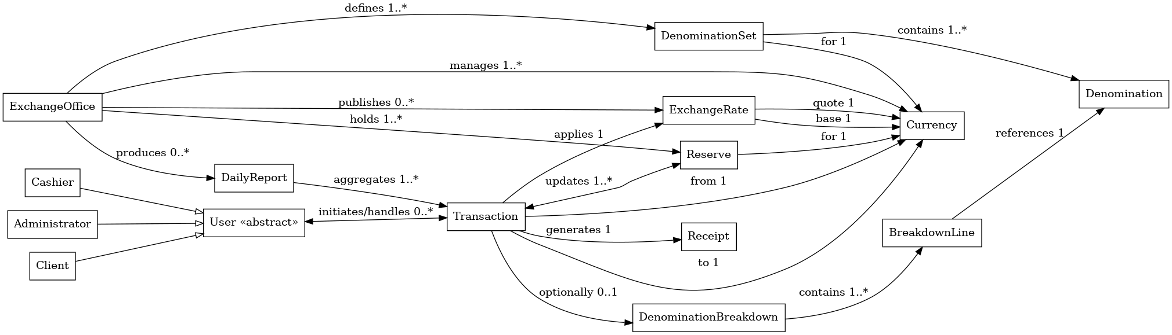
Conceptual Class Diagram

Slide 6
CRC Cards
ExchangeOffice
Responsibilities: Manage reserves and currencies Define denomination sets Publish exchange rates Produce daily reports | Collaborators: Reserve, Currency, ExchangeRate, DenominationSet, DailyReport
Transaction
Responsibilities: Apply exchange rate Update reserves Generate receipt Optionally create denomination breakdown | Collaborators: ExchangeRate, Reserve, Receipt, DenominationBreakdown, User
User (Cashier, Administrator, Client)
Responsibilities: Initiate and handle transactions Cashier: perform exchanges, create reports Administrator: manage rates and reserves Client: request exchange, receive receipt | Collaborators: Transaction, Receipt, DailyReport, ExchangeRate, Reserve
ExchangeRate
Responsibilities: Provide base and quote currency values Serve as reference for calculations | Collaborators: Currency, Transaction

Slide 7
Traceability Table
User Story | CRC Responsibility | Simple Class Diagram Element | C++ Element
Client wants to exchange currency and get the payout amount | CurrencyManager: converts via LOC; Transaction: records details | Transaction, ExchangeRate, Currency | CurrencyManager::convert_via_local(from,to,amount, &rate_from_loc,&rate_to_loc,&profit_delta_loc) (currency_manager.cpp);
Cashier/Administrator wants to set and view fixed exchange rates | ExchangeRate: stores BUY/SELL to LOC; ExchangeOffice: publishes rates | ExchangeRate for each Currency | scenario_mgmt_set_rates() and scenario_show_rates() (main.cpp);
Manager wants daily summary (count + profit) | DailyReport/Report: aggregates transactions, totals profit | DailyReport aggregates Transaction | generate_daily_summary(date) and csv_sum_profit_for_date(date,&count) (utils.cpp);

Slide 8
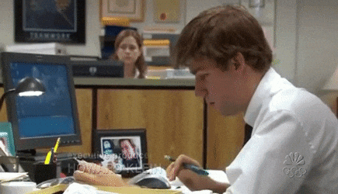
Team Roles
Kuzey Arda Bulut – Coding, reporting and presentation

Slide 9

Lessons Learned
Working Solo
Learning about Traceability Table
Making a presentation
C Coding

Slide 10
QUESTIONS???

Slide 11

THANKS FOR lISTENING!!
KUZEY aRDA bULUT
@kuzeyardabulut

